Slide 1
JAVA SEMINAR
4. Write a program to present an address book app that enables you to browse existing entries, add newentries and search for entries with a specific last name using prepared statements.

Slide 2
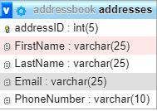
DATABASE:

Slide 3
STEPS:
Create JdbcRowSet object and set database credentials for the object to connect to the database.
Also pass command to the object for output.
Get metadata from rowset object.
Print the details in the rowset by using metadata information like column count and column name.

Slide 4
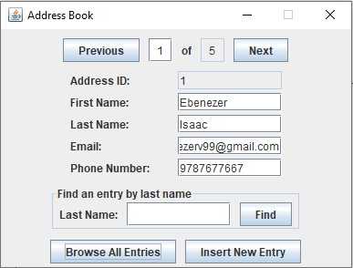
OUTPUT:

Slide 5
